Slide 1
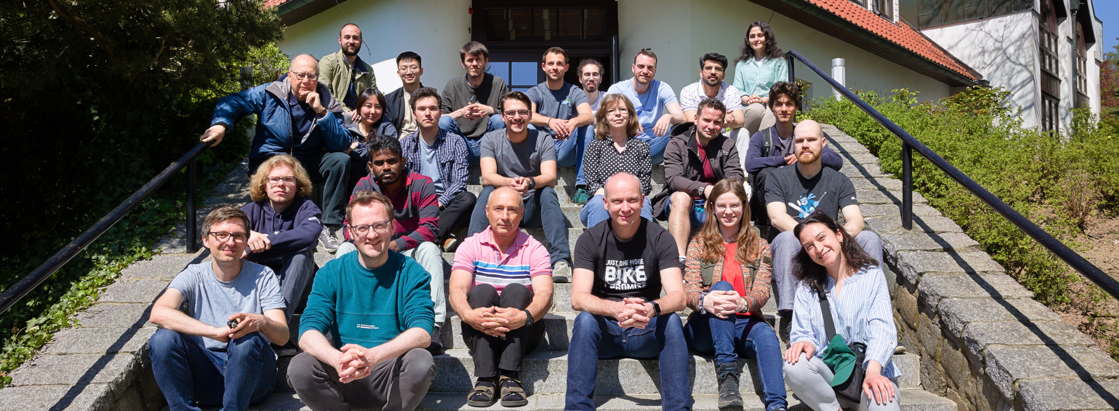
Tiny CNN with microfluidic pipes
Jorge Torres Gómez | Telecommunication Networks

Slide 2
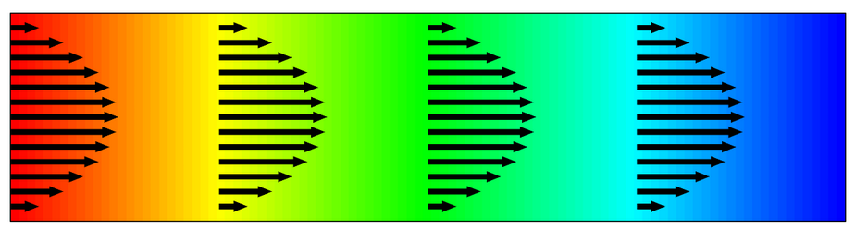

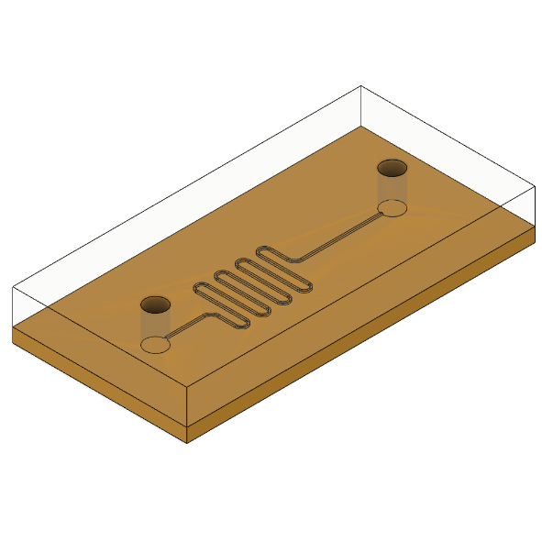
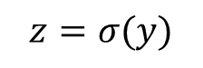
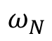
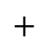
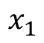

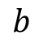
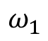
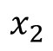
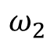
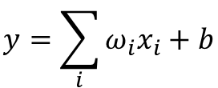
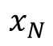
Bio-Computing
Single Neuron Scheme
Digital Computing
Chemical Reaction Networks
DSP
Microfluidic Chips
$$b$$
Activation
Function
$$x_{1}$$
$$ω_{N}$$
$$y=\sum_{i}{ω_{i}x_{i}}+b$$
$$x_{2}$$
$$ω_{2}$$
$$+$$
$$z=σ(y)$$
$$⋯$$
$$x_{N}$$
$$ω_{1}$$
Transport of Diluted Species
Chemical
Reaction
[1] A. O. Bicen and I. F. Akyildiz, “System-Theoretic Analysis and Least-Squares Design of Microfluidic Channels for Flow-Induced Molecular Communication,” IEEE Transactions on Signal Processing, vol. 61, no. 20, pp. 5000–5013, Oct. 2013, doi: 10.1109/TSP.2013.2274959.
Microfluidic Circuit
2

Slide 3
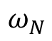
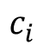
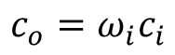
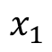
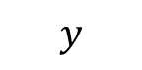
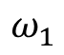
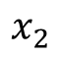
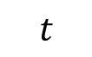
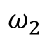
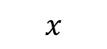
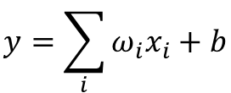
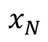
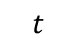
Concept
Single Neuron Scheme
Digital Computing
Chemical Reaction Networks
DSP
Microfluidic Chips
$$b$$
Activation
Function
$$x_{1}$$
$$ω_{N}$$
$$y=\sum_{i}{ω_{i}x_{i}}+b$$
$$x_{2}$$
$$ω_{2}$$
$$+$$
$$z=σ(y)$$
$$⋯$$
$$x_{N}$$
$$ω_{1}$$
$$y$$
Transport of Diluted Species
Inlet
Outlet
$$x$$
$$c_{i}$$
$$c_{o}=ω_{i}c_{i}$$
$$t$$
$$t$$
3

Slide 4
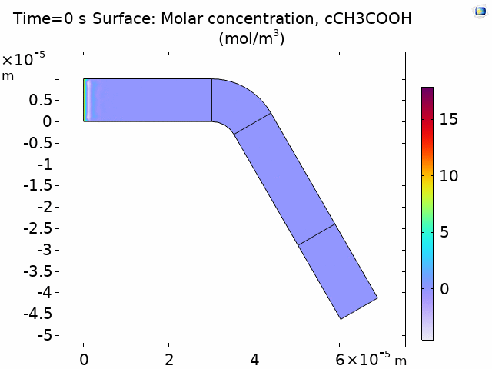

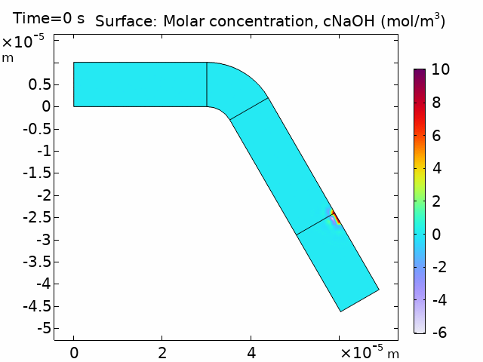

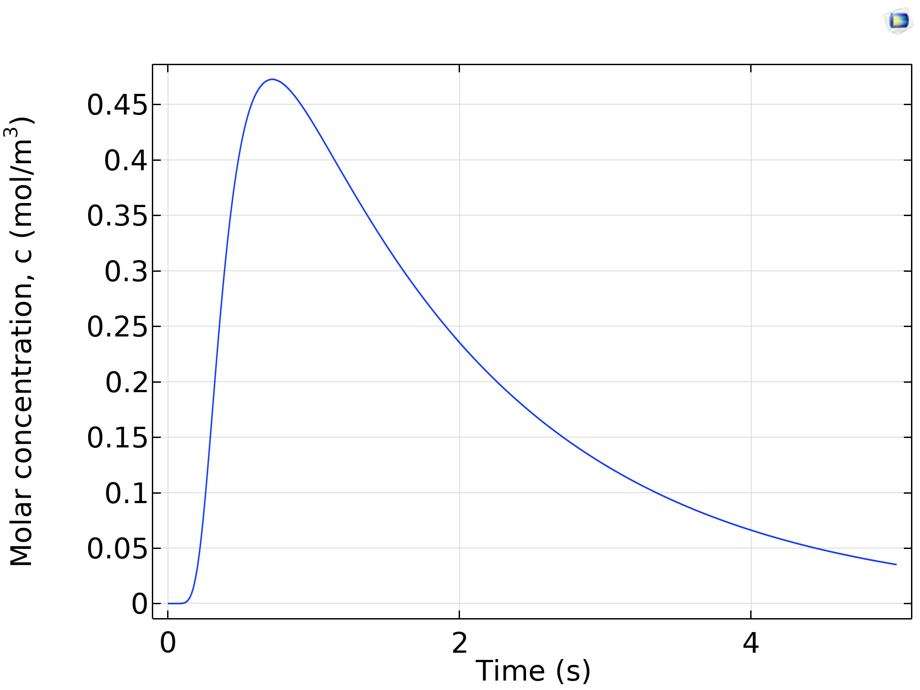
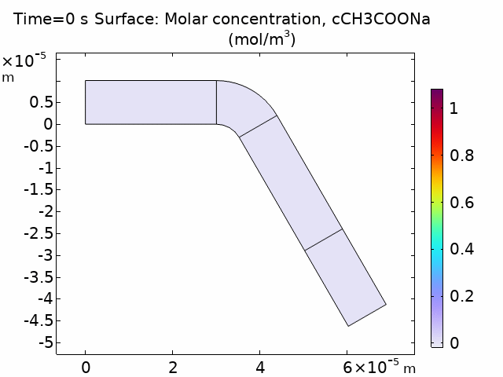
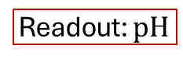
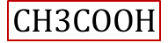
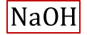
Concept
Activation
Function
$$NaOH$$
$$CH3COOH$$
$$NaOH+CH3COOH →CH3COONa+H2O$$
Readout: $pH$
4

Slide 5

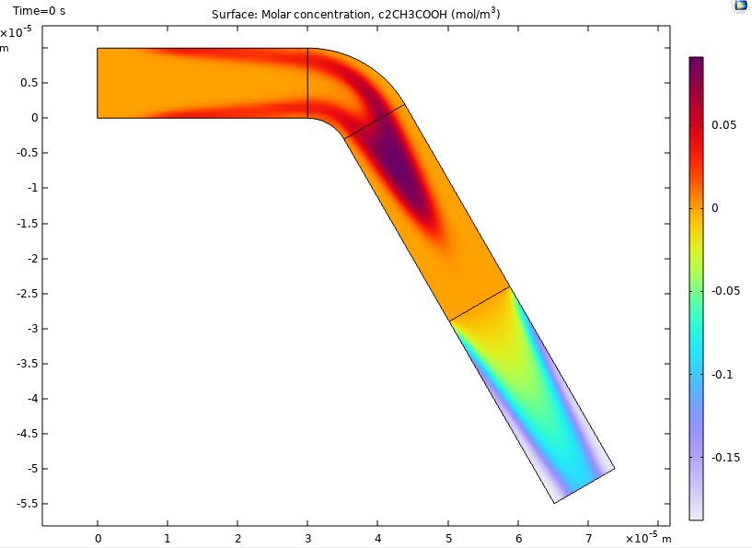
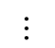
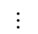
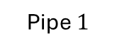
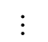
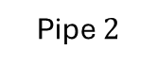
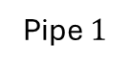
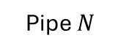
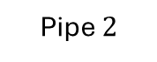
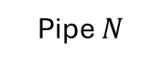
Concept
Single Neuron Scheme
Pipe $N$
$$⋯$$
Pipe $2$
Inlets
Inlet B
Pipe $1$
Outlet
Chemical Reactor
Combiner
CNN-like Scheme
Pipe $N$
$$⋯$$
$$⋯$$
Inlet B
Pipe $2$
Inlet A
Outlet
Pipe $1$
Chemical Reactor
Splitter
Combiner
5

Slide 6
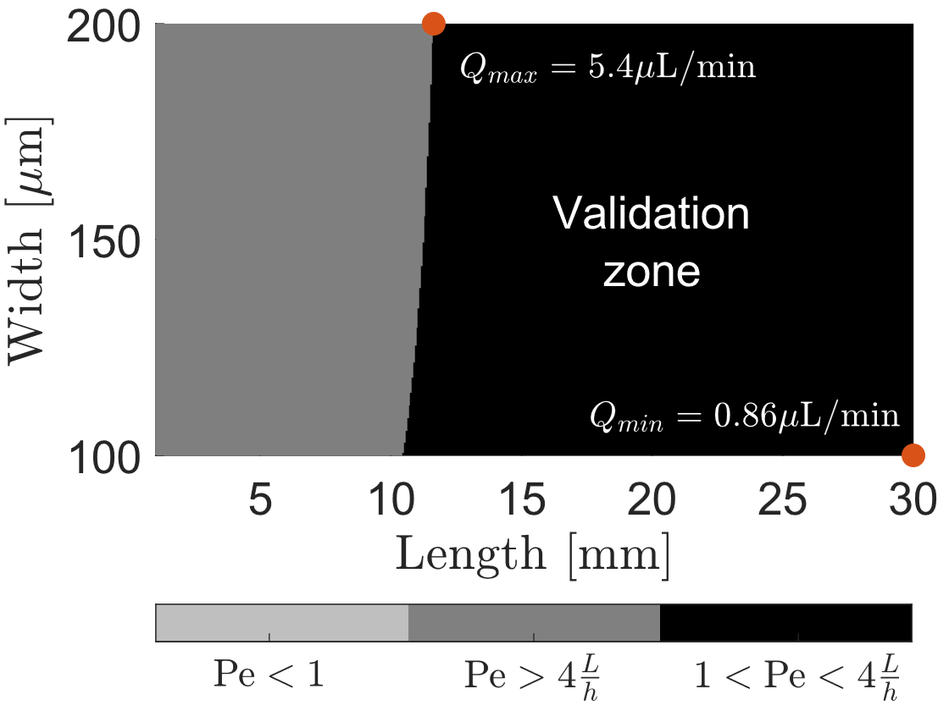
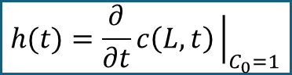
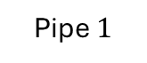
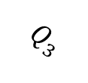
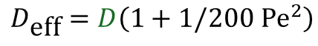

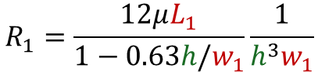
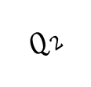











Synthesis
CNN-like Scheme
Pipe $2$
$$Q_{2}$$
Pipe $1$
Define the sampling time on Pipe 1
$$∆P$$
$$Q_{1}$$
$$L_{1}$$
$$w_{1}$$
Outlet
$$c\left(L,t\right)=\frac{1}{2}C_{0}\text{erfc}\frac{L_{1}−v_{\text{char}}t}{2\sqrt{D_{\text{eff}} t}}$$
$$\sqrt{48}≪\text{Pe}≪4\frac{L}{r}$$
$$Q_{3}$$
Pipe $3$
$$h(t)=\frac{∂}{∂t}c\left(L,t\right){\left.​\right|}_{C_{0}=1}$$
Peclet number condition
Parameter | Value
$h$ | $50 μm$
$∆P$ | $600$ Pa
$D$ Tartrazine | $4.9∙{10}^{−10} [m^{2}/s]$
$$v_{\text{char}}=\overline{v}=\frac{Q_{1}}{w_{1}h}$$
$$Q_{1}=\frac{∆P }{R_{1}}$$
$$R_{1}=\frac{12μL_{1}}{1−0.63h/w_{1}}\frac{1}{h^{3}w_{1}}$$
$$\text{Pe}=\frac{h^{2}v_{\text{char}}}{D}$$
$$D_{\text{eff}}=D\left(1+1/200 {\text{Pe}}^{2}\right)$$
6

Slide 7









Synthesis
Parameter | Value
$h$ | $50 μm$
$∆P$ | $600$ Pa
$D$ Tartrazine | $4.9∙{10}^{−10} [m^{2}/s]$
CNN-like Scheme
Pipe $2$
$$Q_{2}$$
Pipe $1$
Define the sampling time on Pipe 1
$$∆P$$
$$Q_{1}$$
$$L_{1}$$
$$w_{1}$$
Outlet
$$c\left(L,t\right)=\frac{1}{2}C_{0}\text{erfc}\frac{L_{1}−v_{\text{char}}t}{2\sqrt{D_{\text{eff}} t}}$$
$$\sqrt{48}≪\text{Pe}≪4\frac{L}{r}$$
(1)
$$Q_{3}$$
Pipe $3$
$$h(t)=\frac{∂}{∂t}c\left(L_{1},t\right){\left.​\right|}_{C_{0}=1}$$
(2)
$$v_{\text{char}}=\overline{v}=\frac{Q_{1}}{w_{1}h}$$
(3)
$$Q_{1}=\frac{∆P }{R_{1}}$$
(4)
$$R_{1}=\frac{12μL_{1}}{1−0.63h/w_{1}}\frac{1}{h^{3}w_{1}}$$
(5)
$$\text{Pe}=\frac{h^{2}v_{\text{char}}}{D}$$
(6)
7
$$D_{\text{eff}}=D\left(1+1/200 {\text{Pe}}^{2}\right)$$
(7)

Slide 8












Synthesis
CNN-like Scheme
Pipe $2$
$$Q_{2}$$
Pipe $1$
Define the sampling time on Pipe 1
$$∆P$$
$$Q_{1}$$
$$L_{1}$$
$$w_{1}$$
Outlet
$$c\left(L,t\right)=\frac{1}{2}C_{0}\text{erfc}\frac{L_{1}−v_{\text{char}}t}{2\sqrt{D_{\text{eff}} t}}$$
$$\sqrt{48}≪\text{Pe}≪4\frac{L}{r}$$
(1)
$$Q_{3}$$
Pipe $3$
$$h(t)=\frac{∂}{∂t}c\left(L_{1},t\right){\left.​\right|}_{C_{0}=1}$$
(2)
Parameter | Value
$h$ | $50 μm$
$∆P$ | $600$ Pa
$D$ Tartrazine | $4.9∙{10}^{−10} [m^{2}/s]$
$$τ=\frac{L_{1}}{v_{\text{char}}}−\frac{2D_{\text{eff}}}{v_{\text{char}}}$$
Pipe $3$
(3)
$$v_{\text{char}}=\overline{v}=\frac{Q_{1}}{w_{1}h}$$
(4)
Pipe $1$
Pipe $2$
$$Q_{1}=\frac{∆P }{R_{1}}$$
$$R_{1}=\frac{12μL_{1}}{1−0.63h/w_{1}}\frac{1}{h^{3}w_{1}}$$
(5)
(6)
$$\text{Pe}=\frac{h^{2}v_{\text{char}}}{D}$$
(7)
$$D_{\text{eff}}=D\left(1+1/200 {\text{Pe}}^{2}\right)$$
(8)
8

Slide 9

















Synthesis
CNN-like Scheme
Pipe $2$
2. Evaluate the design in COMSOL
$$Q_{2}$$
Pipe $1$
$$∆P$$
$$Q_{1}$$
$$L_{1}$$
$$w_{1}$$
Outlet
Parameter | Value
$h$ | $50 μm$
$∆P$ | $600$ Pa
$D$ Tartrazine | $4.9∙{10}^{−10} [m^{2}/s]$
$$τ=\frac{L}{v_{\text{char}}}−\frac{2D_{\text{eff}}}{v_{\text{char}}}$$
$$Q_{3}$$
(1)
Pipe $3$
9

Slide 10



Synthesis
CNN-like Scheme
Parameter | Value
$h$ | $50 μm$
$∆P$ | $600$ Pa
$D$ Tartrazine | $4.9∙{10}^{−10} [m^{2}/s]$
Pipe $2$
$$Q_{2}$$
Pipe $1$
$$∆P$$
$$Q_{1}$$
$$L_{1}$$
$$w_{1}$$
Outlet
$$Q_{3}$$
Pipe $3$
$$∆τ→∆L$$
3. Find the correction
4. Re-design in COMSOL
$$∆τ=\frac{∆L}{v_{\text{char}}}−\frac{2D_{\text{eff}}}{v_{\text{char}}}$$
(1)
10

Slide 11


Experiment 1: Design 1.1
Design 1.1
Pipe 2
Pipe 1
Purpose
Validate the synchronization of pulses through the three different pipes.
Architecture
Transmitter + CNN
Dimensions
Total size: 4.8 x 2.9 cm
Chemicals
Tartrazine and H2O
Study phase
Theoretical calculations completed
Simulation in COMSOL completed
Experimental validation is missing
Pipe 3

Slide 12

Experiment 1: Design 1.1
Purpose
Validate the synchronization of pulses through the three different pipes.
Architecture
Transmitter + CNN
Dimensions
Total size: 4.8 x 2.9 cm
Chemicals
Tartrazine and H2O
Study phase
Theoretical calculations completed
Simulation in COMSOL completed
Experimental validation is missing

Slide 13
Experiment 1: Design 1.1
Design 1.1
Pipe 2
Pipe 1
Purpose
Validate the synchronization of pulses through the three different pipes.
Architecture
Transmitter + CNN
Dimensions
Total size: 4.8 x 2.9 cm
Chemicals
Tartrazine and H2O
Study phase
Theoretical calculations completed
Simulation in COMSOL completed
Experimental validation is missing
Pipe 3

Slide 14




glucose
concentration
Single Neuron Scheme
Pipe $N$
$$⋯$$
Pipe $2$
Inlets
Inlet B
Pipe $1$
Outlet
Chemical Reactor
Combiner
time
serial-to-parallel
converter

Slide 15


























Analysis
$$y$$
$$y_{ro}$$
Derivative of the Step-response
$$c(x_{0},t)$$
$$r_{out}$$
$$c(x_{1},t)$$
$$r_{in}$$
$$c(x_{2},t)$$
$$x$$
(1)
$$l$$
$$φ$$
$$c_{r}(x_{ro},t)$$
(2)
O
$$x_{ro}$$
$${\overline{c}}_{r}(x_{ro},y_{ro},t)$$
(3)
$$y$$
$$c(x_{0},t)$$
$$c(x_{1},t)$$
$$c(x_{2},t)$$
$$l$$
(4)
(5)
$$x$$
(6)
15

Slide 16














Analysis
$$y$$
$$y_{ro}$$
$$r_{in}$$
$$r_{out}$$
$$c(x_{1},t)$$
$$c(x_{2},t)$$
$$c(x_{0},t)$$
$$x$$
$$l$$
Derivative of the Step-response
$$φ$$
$$c_{r}(x_{ro},t)$$
O
(1)
$$x_{ro}$$
$$x_{ro}$$
(2)
16

Slide 17








Analysis
$$y$$
$$y_{ro}$$
$$r_{in}$$
$$r_{out}$$
$$c(x_{1},t)$$
$$c(x_{2},t)$$
Derivative of the Step-response
$$x$$
$$c(x_{0},t)$$
$$l$$
$$φ$$
$$c_{r}(x_{ro},t)$$
(1)
O
$$x_{ro}$$
$φ=\frac{π}{3}$ $r=20$ μm
$L=3$ mm $r=20$ μm
$L=3$ mm $φ=\frac{π}{3}$
17

Slide 18







Application
CNN-like Scheme
Pipe $N$
$$⋯$$
500 μm to 1 mm
Inlet B
$$⋯$$
Inlet C
Communication Channel
Pipe $2$
Inlet A
Outlet
Pipe $1$
Outlet
Definitions
Chemical Element.
Fluid element.
Pressure.
Size of pipes.
Design of the electronic components
[1] M. M. Albay, E. Akyol, F. Mirlou, L. Beker, and M. Kuscu, “Low-cost Microfluidic Testbed for Molecular Communications with Integrated Hydrodynamic Gating and Screen-printed Sensors,” Jan. 31, 2025, arXiv: arXiv:2501.19341. doi: 10.48550/arXiv.2501.19341.
18

Slide 19











Application
$3×5$ cm
CNN-like Scheme
Pipe $3$
Transmitter
1mm to 4 mm
Inlet B
$$⋯$$
Pipe $2$
Communication Channel
Inlet C
Inlet A
Outlet B
Pipe $1$
Outlet A
Time to fill-in
$∆t={V_{L}}/{Q_{min}}$
$∆t= {2πr^{2}×{heigth}_{max}}/{Q_{min}}$
Flow max
$Q=0.5−7$ μl/min
Height
$\text{10−}\text{50}$ μm
Width: minimum
$\text{5}\text{0}\text{−500}$ μm
NaOH
$$r=50 \text{μ}\text{m}$$ | $$Q=1.89 \text{μ}\text{l}\text{/}\text{min}$$ | $T_{b}=5$ s | $∆t=635$ ms | $≈12\%$
$$r=100 \text{μ}\text{m}$$ | $Q=6.9$ μl/min | $T_{b}=4$ s | $∆t=410$ ms | $≈10\%$
$$r=250 \text{μ}\text{m}$$ | $Q=2.4$ μl/min | $T_{b}=5$ s | $∆t=1.17$s | $≈30\%$
19

Slide 20





Application
$3×5$ cm
CNN-like Scheme
Pipe $3$
Transmitter
500 μm to 1 mm
Inlet B
$$⋯$$
Pipe $2$
Communication Channel
Inlet C
Inlet A
Outlet B
Pipe $1$
Outlet A
20

Slide 21






















Design 1.0
$$P_{u32}$$
$$P_{b32}$$
$$P_{u22}$$
Pipe $3$
$$⋯$$
$$P_{u31}$$
$$P_{b22}$$
Pipe $2$
$$P_{u0}$$
$$P_{u33}$$
$$P_{u11}$$
$$P_{b31}$$
$$P_{u21}$$
$$P_{b21}$$
$$P_{b23}$$
$$P_{u23}$$
$$P_{b33}$$
Pipe $1$
$$P_{b0}$$
$$P_{b12}$$
$$P_{b13}$$
$$P_{b11}$$
21

Slide 22

Design 1.0
22

Slide 23




Design 2
Pipe $3$
Inlet B
$$⋯$$
Pipe $2$
Pipe $1$
Inlet A
Outlet B
Outlet A
Outlet C
23

Slide 24
Design 3
Chemical Reactor
Inlet B
Inlet C
Inlet A
Outlet B
Outlet A
24

Slide 25




Design 4
CNN-like Scheme
Pipe $3$
Transmitter
Communication Channel
Chemical Reactor
Inlet B
$$⋯$$
Pipe $2$
Inlet C
Pipe $1$
Inlet A
Outlet B
Outlet A
Outlet C
25

Slide 26

Application
Pipe $3$
Inlet B
$$⋯$$
Pipe $2$
Inlet C
Inlet A
Outlet B
Pipe $1$
Outlet A
26

Slide 27
Application
CNN-like Scheme
Pipe $N$
$$⋯$$
500 μm to 1 mm
Inlet B
$$⋯$$
Inlet C
Communication Channel
Pipe $2$
Inlet A
Outlet
Pipe $1$
Outlet
27

Slide 28
Application
$3×5$ cm
CNN-like Scheme
Pipe $3$
Transmitter
500 μm to 1 mm
Inlet B
$$⋯$$
Pipe $2$
Communication Channel
Inlet C
Inlet A
Outlet B
Pipe $1$
Outlet A
28

Slide 29

















Synthesis
Pipe $2$
Pipe $3$
Pipe $3$
Pipe $1$
Inlet B
$$⋯$$
Pipe $2$
Inlet C
Inlet A
Outlet B
Pipe $1$
Outlet A
NaOH
Radius: $r∈50−70$ μm
Pipe $3$
Pipe $2$
Pipe $1$
Pipe $2$
Pipe $3$
Pipe $1$
29

Slide 30









Synthesis
Pipe $2$
Pipe $3$
Pipe $3$
Pipe $1$
Inlet B
$$⋯$$
Pipe $2$
Inlet C
Inlet A
Outlet B
Pipe $1$
Outlet A
NaOH
Radius: $r∈50−70$ μm
Pipe $1$
Pipe $2, L_{1}=16.5$ mm
Pipe $3, L_{1}=16.5 \text{mm}$
30

Slide 31



Synthesis
Pipe $2$
Pipe $3$
Pipe $3$
Pipe $1$
Inlet B
$$⋯$$
Pipe $2$
Inlet C
Inlet A
Outlet B
Pipe $1$
Outlet A
NaOH
Radius: $r∈120−150$ μm
Pipe $1$
Pipe $2$
Pipe $2$
Pipe $3$
Pipe $1$
Pipe $3$
31

Slide 32




Synthesis
Pipe $2$
Pipe $3$
Pipe $3$
Pipe $1$
Inlet B
$$⋯$$
Pipe $2$
Inlet C
Inlet A
Outlet B
Pipe $1$
Outlet A
NaOH
Radius: $r∈100−120$ μm
Pipe $1$
Pipe $2, L_{1}=16.5$ mm
Pipe $3, L_{1}=16.5 \text{mm}$
32

Slide 33














Synthesis
Pipe $2$
Pipe $3$
Pipe $2$
Pipe $1$
Inlet B
$$⋯$$
Pipe $2$
Inlet C
Inlet A
Outlet B
Pipe $1$
Outlet A
NaOH
Radius: $r∈250−270$ μm
Pipe $2$
Pipe $3$
Pipe $2$
Pipe $3$
Pipe $1$
Pipe $1$
33

Slide 34







Synthesis
Pipe $2$
Pipe $3$
Pipe $2$
Pipe $1$
Inlet B
$$⋯$$
Pipe $2$
Inlet C
Inlet A
Outlet B
Pipe $1$
Outlet A
NaOH
Radius: $r∈250−270$ μm
34

Slide 35







Synthesis
Pipe $2$
Pipe $3$
Pipe $2$
Pipe $1$
Inlet B
$$⋯$$
Pipe $2$
Inlet C
Inlet A
Outlet B
Pipe $1$
Outlet A
NaOH
Radius: $r∈250−270$ μm
Pipe $1$
Pipe $2, L_{1}=28.3$ mm
Pipe $3, L_{1}=28.3 \text{mm}$
35

Slide 36













Synthesis
Pipe $3$
Inlet B
$$⋯$$
Pipe $2$
Inlet A
Outlet B
Pipe $1$
Outlet A
Tartrazine
Radius: $r∈250−270$ μm
Pipe $1$
Pipe $2$
Pipe $3$
Pipe $3$
Pipe $2$
Pipe $1$
36

Slide 37






Synthesis
Pipe $2$
Pipe $3$
Pipe $2$
Pipe $1$
Inlet B
$$⋯$$
Pipe $2$
Inlet A
Outlet B
Pipe $1$
Outlet A
Tartrazine
Radius: $r∈100−120$ μm
Pipe $1$
Pipe $2, L_{1}=26.6$ mm
Pipe $3, L_{1}=26.6 \text{mm}$
37

Slide 38









Synthesis
CNN-like Scheme
Pipe $N$
$$⋯$$
$$⋯$$
Inlet B
Pipe $2$
Inlet A
Outlet
Pipe $1$
Chemical Reactor
Splitter
Combiner
Design constraints
(1)
(2)
(3)
38

Slide 39







Synthesis
CNN-like Scheme
Pipe $N$
$$⋯$$
$$⋯$$
Inlet B
Pipe $2$
Inlet A
Outlet
Pipe $1$
Chemical Reactor
Splitter
Combiner
39

Slide 40


Synthesis
CNN-like Scheme
Design constraints
Pipe $N$
(1)
$$⋯$$
$$⋯$$
Inlet B
Pipe $2$
(2)
Inlet A
Outlet
Pipe $1$
Chemical Reactor
Splitter
Combiner
(3)
40

Slide 41


Synthesis
CNN-like Scheme
Design constraints
Pipe $N$
(1)
$$⋯$$
$$⋯$$
Inlet B
Pipe $2$
(2)
Inlet A
Outlet
Pipe $1$
Chemical Reactor
Splitter
Combiner
(3)
41

Slide 42


Synthesis
CNN-like Scheme
Pipe $N$
$$NaOH+CH3COOH →CH3COONa+H2O$$
$$⋯$$
$$⋯$$
Inlet B
Pipe $2$
Inlet A
Outlet
Pipe $1$
Chemical Reactor
Splitter
Combiner
42

Slide 43


Bio-Computing
Digital Computing
Chemical Reaction Networks
DSP
Microfluidic Chips
43

Slide 44





Linear Component: $ω_{i}∙x_{i}$
$$ω_{1}$$
$$ω_{2}$$
44

Slide 45

Bio-Computing
Analog Computing
Wet-Neuromorphic Computing
Chemical Reaction Networks
Compartment Based
Models
Reservoir Computing
J. Perera et al., “Wet-Neuromorphic Computing: A New Paradigm for Biological Artificial Intelligence,” IEEE Intelligent Systems, pp. 1–7, 2025. DOI: 10.1109/mis.2025.3555551.

Slide 46

Bio-Computing
Analog Computing
Wet-Neuromorphic Computing
Chemical Reaction Networks
Compartment Based
Models
Reservoir Computing
J. Perera et al., “Wet-Neuromorphic Computing: A New Paradigm for Biological Artificial Intelligence,” IEEE Intelligent Systems, pp. 1–7, 2025. DOI: 10.1109/mis.2025.3555551.

Slide 47


Bio-Computing
Analog Computing
Wet-Neuromorphic Computing
Chemical Reaction Networks
Compartment Based
Models
Reservoir Computing
J. Perera et al., “Wet-Neuromorphic Computing: A New Paradigm for Biological Artificial Intelligence,” IEEE Intelligent Systems, pp. 1–7, 2025. DOI: 10.1109/mis.2025.3555551.

Slide 48

Bio-Computing
[1] S. Balasubramaniam, S. Somathilaka, S. Sun, A. Ratwatte, and M. Pierobon, “Realizing Molecular Machine Learning Through Communications for Biological AI,” IEEE Nanotechnology Magazine, vol. 17, no. 3, pp. 10–20, Jun. 2023, doi: 10.1109/MNANO.2023.3262099.

Slide 49

Bio-Computing
Digital Computing
Chemical Reaction Networks
DSP
Microfluidic Chips
Analog Computing
Wet-Neuromorphic Computing
Chemical Reaction Networks
Compartment Based Models
Reservoir Computing
$\sim 300$ learnable parameters

Slide 50

Datasets
50

Slide 51
Communicating Smartly at the Nanoscale - Neural Networks Developments in Molecular Communication
Jorge Torres Gómez | Telecommunication Networks

Slide 52
nanoAI Lab: A new research group
Jorge Torres Gómez | Telecommunication Networks

Slide 53



Research groups in our Network
General Purpose AI for IoBNT Applications
Micro-fluidic circuits
Werner Haselmayr
Ozgur Baris Akan
H. Birkan Yilmaz
Functionalized Graphene
Ozgur Baris Akan

Slide 54





Grant programs: National
Discovery Grants
Address higher-risk (higher reward) topics.
Discovery Horizons/Alliance Society
Investigator-initiated individual and team projects.
Interdisciplinary research.
Exploration
Competition-based
Interdisciplinary research.
Promote relevant collaborations across disciplines, professions, and sectors.

Slide 55



Grant programs: International
International
Competition based
Four years funding
Funding for one year to initiate international research collaborations
International Partners:
Turkey (Koc Uni., Bogazici Uni.)
Germany (TU Berlin, TU Dresden, TU Darmstadt, Erlangen)
Norway (Oslo University Hospital)
Sweeden (Uppsala University)
Spain (Polytechnic University of Barcelona)
Italy (University of Milano)
US (Northeastern University, Michigan University, Nebraska)
Join and lead consortium projects among 3 countries at least (EU+Canada)

Slide 56


NanoAI Lab: MOU Network
Deciphering Gene Regulation in Bacteria
Lourdes Pena-Castillo
Computer Science
https://www.cs.mun.ca/~lourdes/public/index.html
Signaling Mechanisms in Cell Survival and Cell Growth
Dr. Brian E. Staveley, Ph.D.
Department of Biology
https://www.mun.ca/biology/bstaveley/
Peptide-Induced Reorganization of Lipid Assemblies
M. R. Morrow
Department of Physics
https://www.physics.mun.ca/~mmorrow/
Hierarchical Materials
Erika Merschrod
Department of Chemistry
https://www.merschrod.group/team.html
Electronic sensor platform

Slide 57
Understanding SeMeCo: Yeast Metabolic Teamwork
Falko Dressler | Telecommunication Networks

